Slide 1
HUMAN VALUES AND PROFESSIONAL ETHICS

Slide 2
Chapter 14- PROFESSIONAL ETHICS IN THE LIGHT OF RIGHT UNDERSTANDING
Profession- In the light of comprehensive human goal
Issues in professional ethics
Topic 3

Slide 3
Topic- Profession- In the light of comprehensive human goal

Slide 4
Q. Profession is a service. Comment.

Slide 5
Q. In what, do the society give value to various professions?

Slide 6
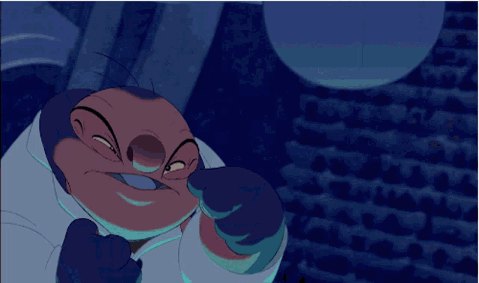
Topic- Issues in professional ethics
Failing in following:-
Honesty
Accountability
Respect
Loyalty
Confidentiality
Obedience to law

Slide 7



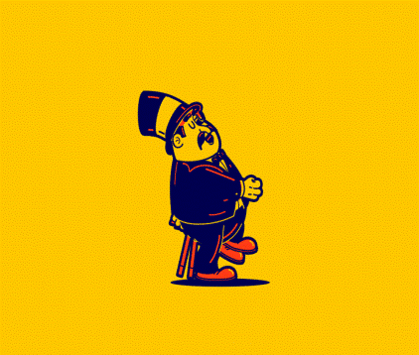
Q. Why does a person go ethically (professionally) irresponsible?
LOW ETHICS
ECONOMIC CRISIS
GREED FOR MONEY
PRESSURE
GREED FOR POWER
FEAR

Slide 8
Q. How can we develop an effective way to ensure professional ethics through right understanding?

Slide 9
Topic-3

Slide 10
Q. Developing ethical competance is the only way of ensuring professional ethics..explain?

Slide 11
Q. "Your Loss is my Gain". In the light of the above statement, tell about the various unethical practices in different professions. And also propose the possible solution.

Slide 12
Summary of questions
Nimisha- Profession is a service. Comment.
Ritika- In what way, do the society give value to various professions?
Manan- why does a person to go professionally unethic?
KHUSHI- How can we develop an effective way to ensure professional ethics through right understanding?
Kripanshu- Developing ethical competance is the only way of ensuring professional ethics..explain?
Mimansa- "Your Loss is my Gain". In the light of the above statement, tell about the various unethical practices in different professions. And also propose the possible solution.

